Slide 1
AZ-400.00 Learning Path 08: Implement continuous feedback

Slide 2
Agenda
Module 01: Implement tools to track usage and flow.
Module 02: Develop monitor and status dashboards.
Module 03: Share knowledge within teams.
Module 04: Design processes to automate application analytics.
Module 05: Manage alerts, Blameless retrospectives and a just culture.
Labs & Learning Path review and takeaways.

Slide 3
Module 01: Implement tools to track usage and flow

Slide 4

Introduction to continuous monitoring
MIGRATE
GOVERN
Policy management
Cost management
SECURE
Security management
Threat protection
CONFIGURE
Configuration
Update management
Automation
Scripting
PROTECT
Backup
Disaster recovery
MONITOR
App, infra & network monitoring Log Analytics & Diagnostics

Slide 5
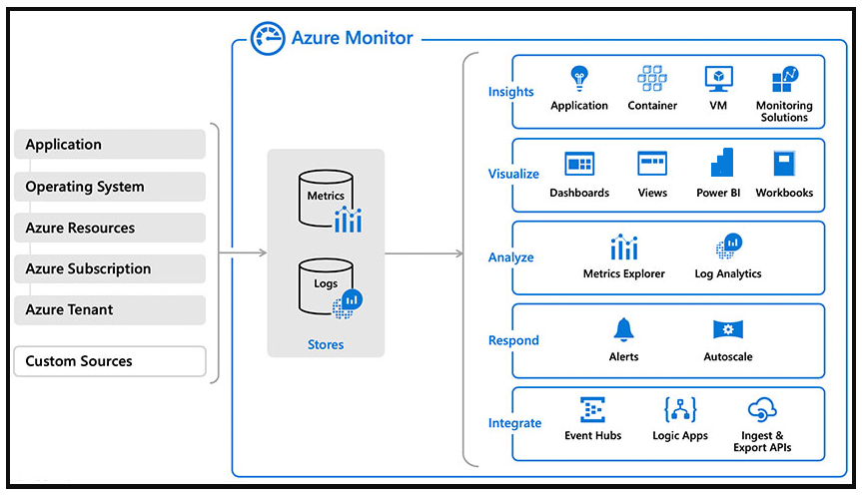
Explore Azure Monitor and Log Analytics
Notes:
Explain about Azure Monitor and suggest to follow the exercise https://docs.microsoft.com/en-us/learn/modules/implement-tools-track-usage-flow/4-explore-azure-monitor-log-analytics or present as Demo.
When you run at cloud scale, you need intelligent logging and monitoring tools that scale to your needs and provide insight into your data in real time.
Azure Monitor is Microsoft's native cloud monitoring solution. Azure Monitor collects monitoring telemetry from different kinds of on-premises and Azure sources.
Azure Monitor provides Management tools, such as those in Azure Security Center and Azure Automation, enabling ingestion of custom log data to Azure.
The service aggregates and stores this telemetry in a log data store optimized for cost and performance.
With Azure Monitor, you can analyze data, set up alerts, get end-to-end views of your applications. And use machine-learning-driven insights to identify and resolve problems quickly.

Slide 6
Examine Kusto Query Language (KQL)
1
KQL is the language used to query Log Analytics
2
Supports queries and control commands
3
Supported within Azure Data Explorer and Azure Data Studio (with notebook support)

Slide 7

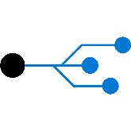
Explore Application Insights
Web pages
Client apps
Alerts
AI
Https request
Power BI
Application Insights
Your Web Services
Visual
Studio
AI
Dependency Calls
REST API
SQL
External Services
Background Services
Continuous
Export
AI
Azure

Slide 8
Implement Application Insights
1
Monitor
2
Detect, diagnose
3
Build, measure, learn

Slide 9
Design and implement metrics and queries
GitHub built-in project tracking:
Azure DevOps built-in project tracking:
Azure Monitor and Application Insights:
Use Insights feature in GitHub projects
Create custom GitHub Actions workflows
Leverage GitHub REST API
Metrics are grouped into several categories
Customizable dashboards
Create custom, query-based reports in Azure DevOps Analytics
Combine continuous monitoring, release annotations, and work items
Optimizes the software development lifecycle

Slide 10
Module 02: Develop monitor and status dashboards

Slide 11
Configure monitoring in GitHub
Configuration:
Creating a chart:
Configuring a chart:
Enable Insights for Projects
Select chart type
Current charts
Historical charts
Create a chart
Configure a chart
Select the Insights icon on the project page
Choose New chart
Configure the chart settings
Apply filters to scope the data
Select the values of properties such as:
Layout
X-axis
Group by (optional)
Y-axis
Count of items
Notes:
Historical charts require GitHub Team and GitHub Enterprise Cloud. Users and organizations have different limits on the number of charts they can create depending on their plan.

Slide 12
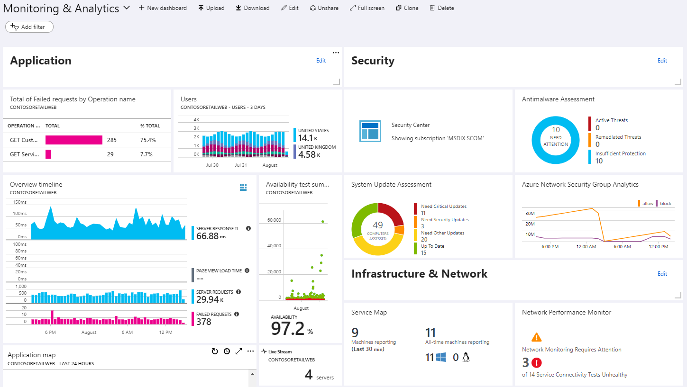
Explore Azure Dashboards

Slide 13
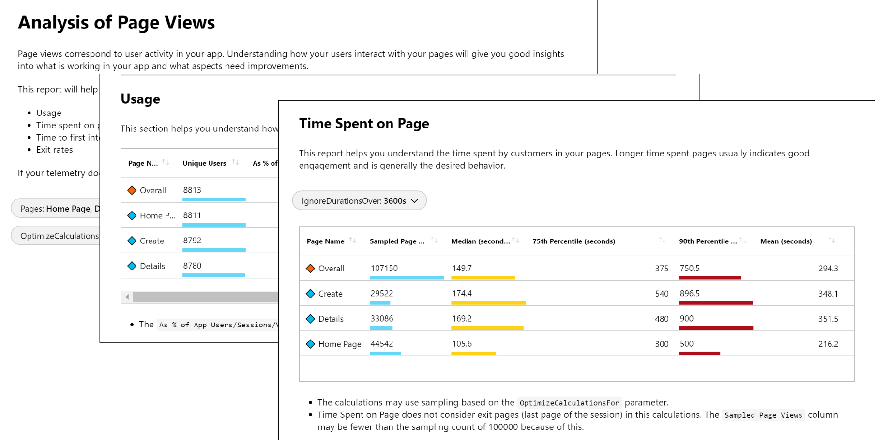
Explore Azure Monitor workbooks

Slide 14
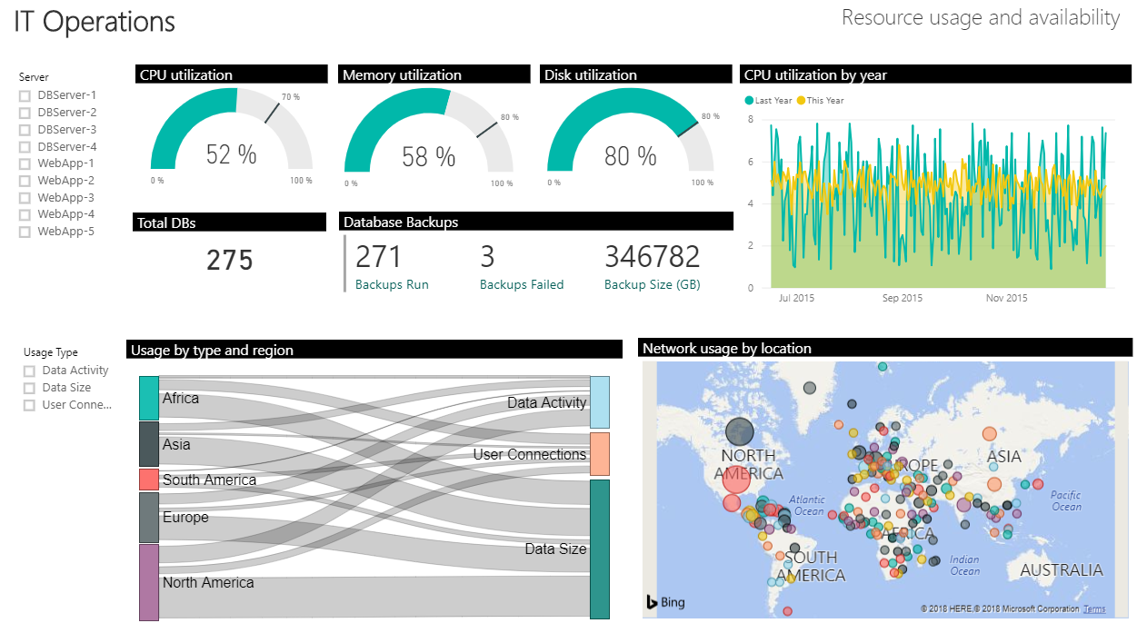
Explore Power BI

Slide 15
Build your own custom application
1
Advantages:
Complete flexibility
Combine metrics and log data
2
Disadvantages:
Significant engineering required

Slide 16
Monitor pipeline health, including failure rate, duration, and flaky tests
Monitoring and assessment targets:
Monitoring and assessment services and tools:
Failure rate
Duration
Flaky tests
Azure Pipelines reports
Application Insights
Service hooks
Third party monitoring tools

Slide 17
Optimize a pipeline for cost, time, performance and reliability
Optimization strategy | Key considerations
Cost optimization | Right-size resources, use Azure spot VMs, review build configurations
Time optimization | Parallelize the build process, leverage caching, minimize unnecessary builds
Performance optimization | Review and optimize scripts and tasks, choose efficient artifact storage solutions, and monitor and tune resource utilization
Reliability optimization | Incorporate retry mechanisms, implement robust error logging and handling, and implement monitoring and alerting

Slide 18
Optimize a pipeline concurrency for performance and cost
Optimization strategy | Key considerations
Utilize parallel jobs and stages | Divide task sequences in pipelines and utilize matrix builds and multi-stage pipelines. Keep a proper balance to minimize costs.
Leverage job dependencies and conditions | Define dependencies between pipeline stages and jobs and use job dependencies and conditions.
Right-size pipeline agents | Choose the appropriate size and type of pipeline agents, create multiple agent pools, use dynamic agent allocation, and implement policies.
Monitor and adjust concurrency settings | Monitor pipeline performance metrics and adjust concurrency settings such as maximum parallelism and agent pool size.
Notes:
Parallel jobs and stages: Parallelism also increases the cost

Slide 19
Module 03: Share knowledge within teams

Slide 20
Share acquired knowledge within development teams
1
Organizational knowledge is acquired over time
2
Organizational knowledge can easily be lost through staff turnover
3
Relearning old lessons is wasteful and expensive
Notes:
See http://owasp.org

Slide 21
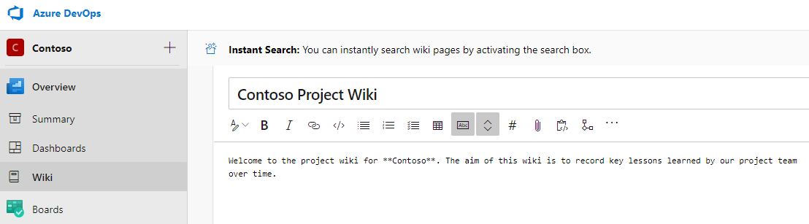
Introduction to Azure DevOps project wikis
Created in Azure DevOps projects, stored in a repository

Slide 22
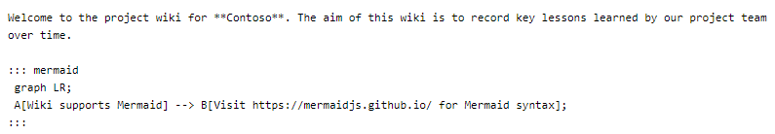
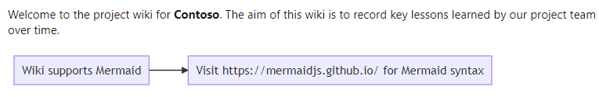
Wiki contents
Written in markdown and can contain file attachments, including videos
Supports insertion of Mermaid diagrams

Slide 23
Integrate GitHub and Azure DevOps with Microsoft Teams
GitHub with Microsoft Teams:
Azure DevOps with Microsoft Teams:
Install the GitHub app for Microsoft Teams from the Microsoft Teams app store or directly from GitHub: http://teams.github.com/
Subscribe to notifications for pull requests and issues using the command: @github subscribe<organization>/<repository>
Customize notifications by subscribing or unsubscribing to specific features using @github subscribe owner/repo [feature] @github unsubscribe owner/repo [feature]
Subscribe to GitHub Actions workflows run notifications
Azure Boards integration
Access the App store in Microsoft Teams, install the app, and use the @azure boards command
Azure Repos integration
Access the App store in Microsoft Teams, install the app, and use the @azure repos command
Azure Pipelines integration
Access the App store in Microsoft Teams, install the app, and use the @azure pipelines command

Slide 24
Module 04: Design processes to automate application analytics

Slide 25
Explore rapid responses and augmented search
1
In Agile teams, issues that “slip through the cracks” directly impact end-users
2
Speedy resolution required – even if root cause determined later
3
Large volume of infrastructure and application logs to search
4
Augmented search uses semantic processing, statistical models, and ML

Slide 26
Integrate telemetry
Benefits:
Challenges:
Provides detailed accurate insights on usage
Monitors an object while physically far removed from it
Do end users want it enabled?
Users might not be comfortable with being monitored

Slide 27
Examine monitoring tools and technologies
1
Synthetic monitoring
2
Alert management
3
Deployment automation
4
Analytics

Slide 28
Explore IT Service Management Connector
Advantages:
Create an incident or alert in your service desk solution based on alerts from Azure
Sync incident data from service desk solution to Azure Log Analytics
Correlate service desk data with Log Analytics data

Slide 29
Module 05: Manage alerts, Blameless retrospectives and a just culture

Slide 30
Examine when to get notifications
Application Insights automatically analyzes the performance of your web application and can warn you about potential problems

Slide 31
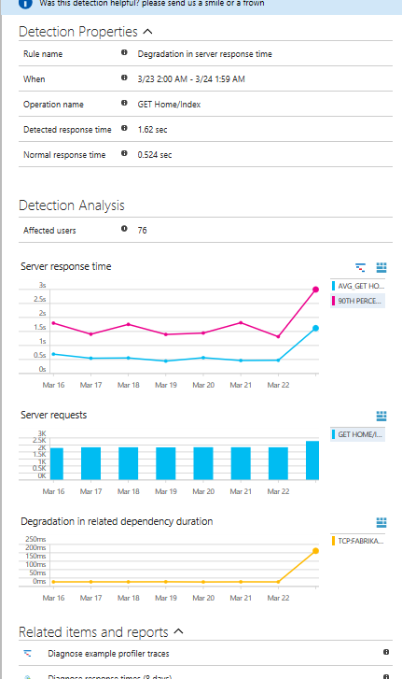
Explore how to fix it
Triage (how many users/ops are affected?)
Scope (all traffic or some pages?)
Diagnose (often will suggest the issue)

Slide 32
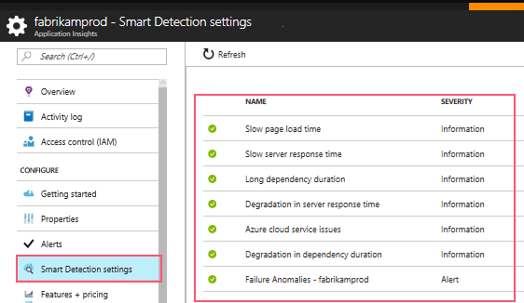
Explore smart detection notifications

Slide 33
Improve performance
1
Triage
2
Diagnose slow page loads
3
Improve slow pages

Slide 34
Example: Understand server response time degradation
1
Response time compared to normal response time
2
Number of affected users
3
Average response time
4
Count of this operation requests on the day of detection and 7 days before
5
Correlation between degradation in this operation and degradations in related dependencies
6
Links to help diagnose the problem

Slide 35
Reduce meaningless and non-actionable alerts
Monitoring and alerting enables a system to tell us when it’s broken, or, potentially, what’s about to break
Alerts requesting immediate action should be urgent, important, actionable, and real

Slide 36
Labs

Slide 37
Lab: Monitoring Application Performance with Azure Load Testing
Objectives:
Deploy Azure App Service web apps
Generate and monitor Azure web app application traffic by using Application Insights
Investigate Azure web app performance by using Application Insights
Track Azure web app usage by using Application Insights
Create Azure web app alerts by using Application Insights
Lab overview:
In this lab, you’ll learn about how you can add Application Insights to an existing web application, as well as how to monitor the application via the Azure portal.
Duration:
Notes:
The labs are updated on a regular basis. For the latest information please visit:
https://microsoftlearning.github.io/AZ400-DesigningandImplementingMicrosoftDevOpsSolutions/

Slide 38
Lab: Sharing team knowledge using Azure project wikis
Objectives:
Lab overview:
Create a wiki in an Azure Project
Add and edit markdown
Create a Mermaid diagram
In this lab, you will create and configure wiki in an Azure DevOps, including managing markdown content and creating a Mermaid diagram.
Duration:
Notes:
The labs are updated on a regular basis. For the latest information please visit:
https://microsoftlearning.github.io/AZ400-DesigningandImplementingMicrosoftDevOpsSolutions/

Slide 39
Closing slide

